Slide 1
United Nations Security Council
A glance at the progression of prominent issues over time
Tyler Vo | Jordan Crivella
Notes:
Tyler – Thank you all for taking the time to listen, today we are taking a look at the UNSC, and how its prominent issues changed over time

Slide 2
Agenda
Data Summary and Processing
Research Question
Visualization
Results
Conclusions
Notes:
Tyler – here is an agenda of what we will talk about to keep you on track. in order to answer our research question, we will look at data and create visualization to come up with conclusions

Slide 3

Research Question
How have the focuses of the permanent members of the United Nations Security Council changed over time?
Research Question Data Summary Data Processing Visualizations Results Conclusions
Notes:
Jordan

Slide 4

Data Description
“UN General Debates”
Text of each country’s
statement translated to
English
What
How
Saved as a CSV file with 4
columns and 199 countries
Utilize Python (Spyder) for
visualization
Why
Covers significant events
Offers a view of each country’s
international diplomacy
Research Question Data Summary Data Processing Visualizations Results Conclusions
Notes:
Jordan

Slide 5
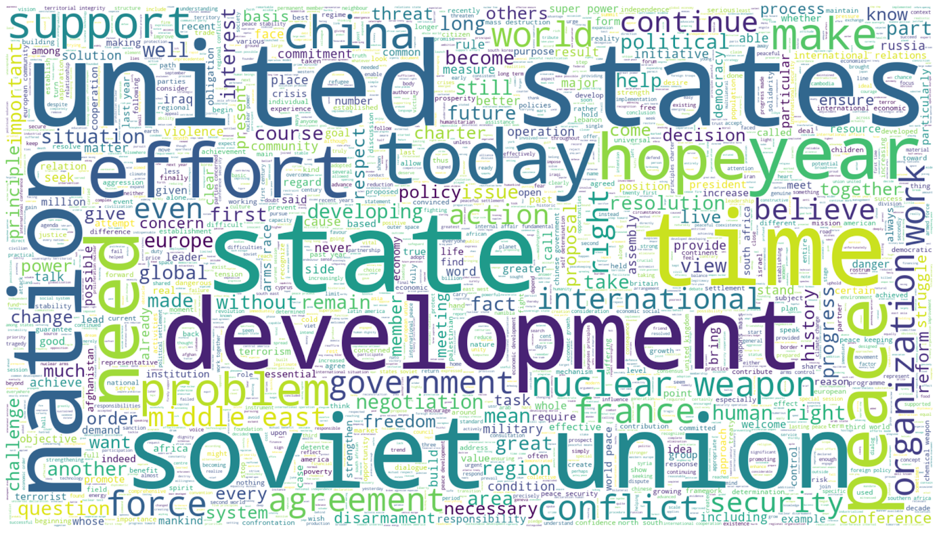
Data Summary
Research Question Data Summary Data Processing Visualizations Results Conclusions
Notes:
Tyler - to introduce you to our data set, here is a word cloud we created from our data, showing the most used words from the permanent members from all sessions. It is very interesting how often the US comes up…

Slide 6

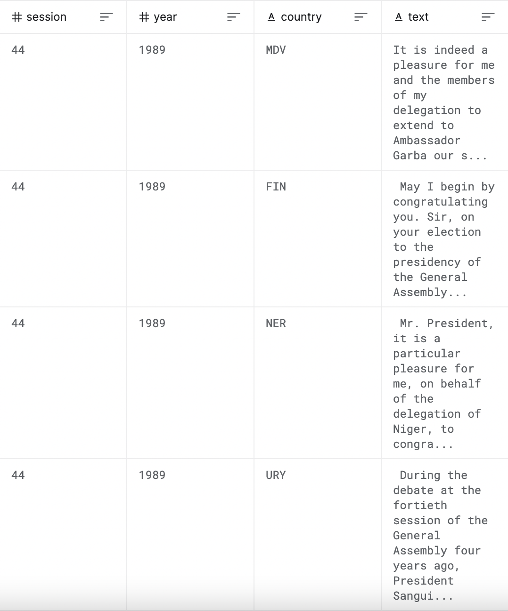



A Look at the Data Set
Session: the UN session. There is one session per year, and the data in this dataset ranges from session 25 to session 71.
Year: The year of the session, from 25 to 71.
Country: The representative’s country, as an ISO 3166 Alpha-3 country code
Text: The complete text of that country’s statement in the general debate from that year, with OCR page numbers removed.
Research Question Data Summary Data Processing Visualizations Results Conclusions
Notes:
Tyler - The data set we used has 4 columns, session, year, country, and text. The session and year correspond, since there is one session per year. The countries are represented by their country codes, and the text each country's statement in the debate for that year

Slide 7

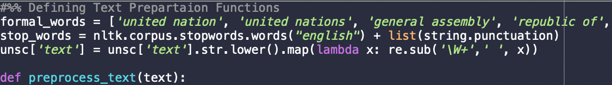

Creating the UNSC Data Frame
1
Filter Out UNSC Permanent Members
2
Remove Unnecessary Words and Lowercase
Research Question Data Summary Data Processing Visualizations Results Conclusions
Notes:
Jordan

Slide 8
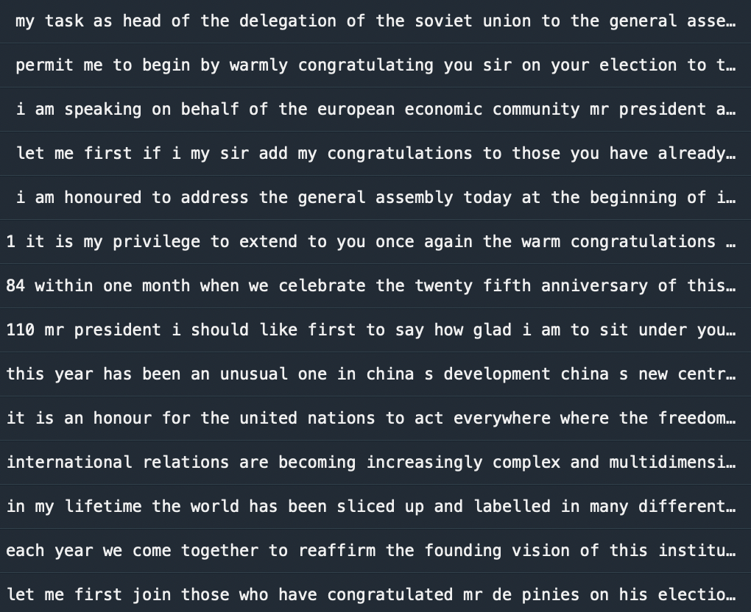
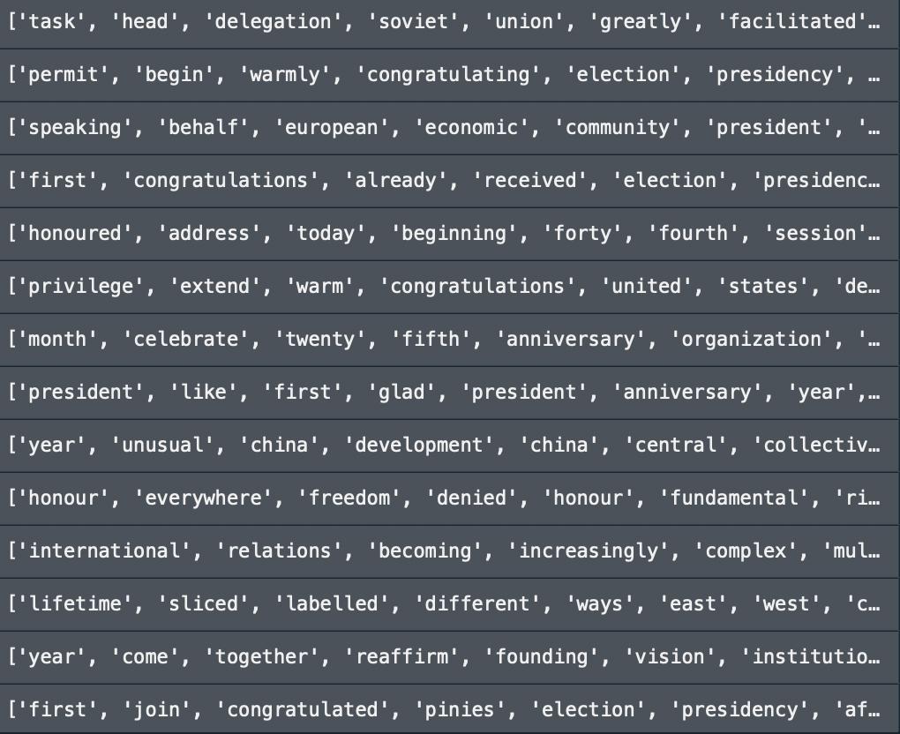
Preparing the Text for Data Processing
3
Tokenize Text into Individual Words
Research Question Data Summary Data Processing Visualizations Results Conclusions
Notes:
Jordan

Slide 9
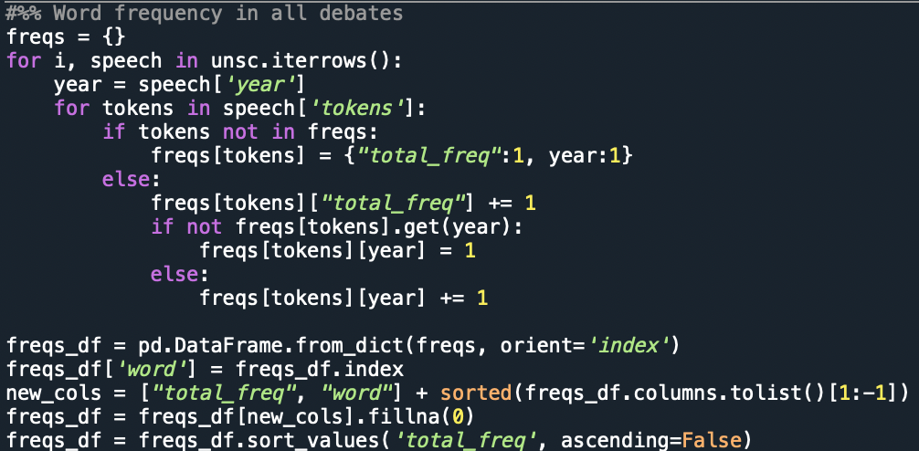
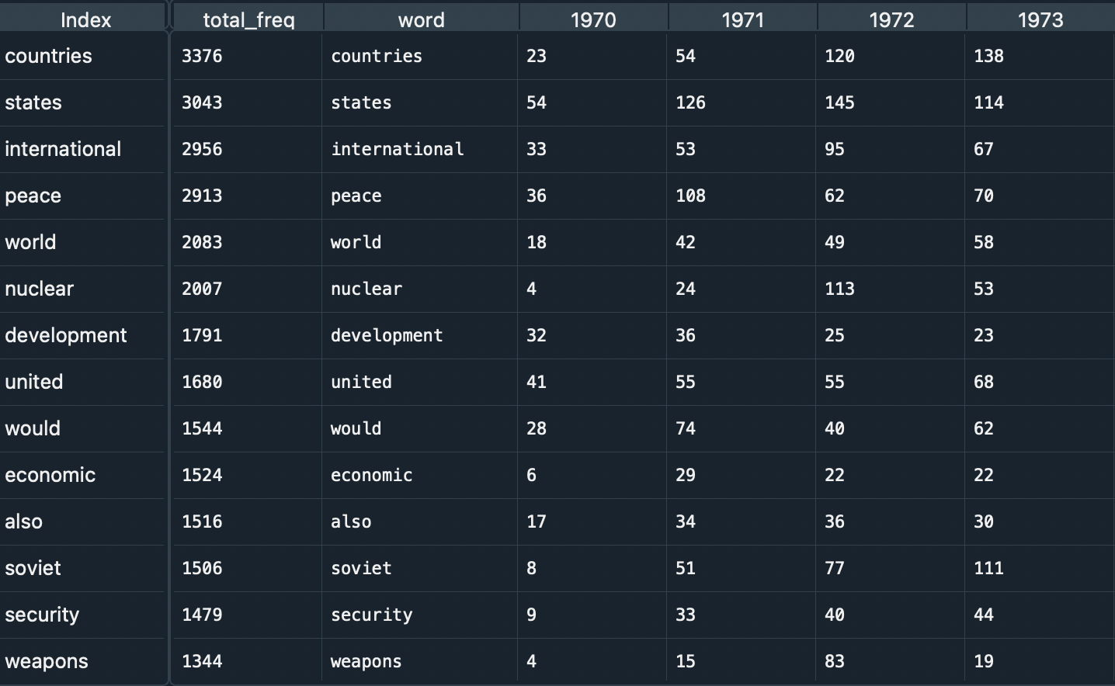

Creating a Frequency Data Frame
4
Create New Data Frame to Determine and Sort Frequency
Research Question Data Summary Data Processing Visualizations Results Conclusions
Notes:
Tyler – Now that all the statements are cleaned and split into lists of strings, we are able to iterate through a for each loop to determine the total frequency and sort each word by year. We have these columns to help us later on when we graph our data

Slide 10
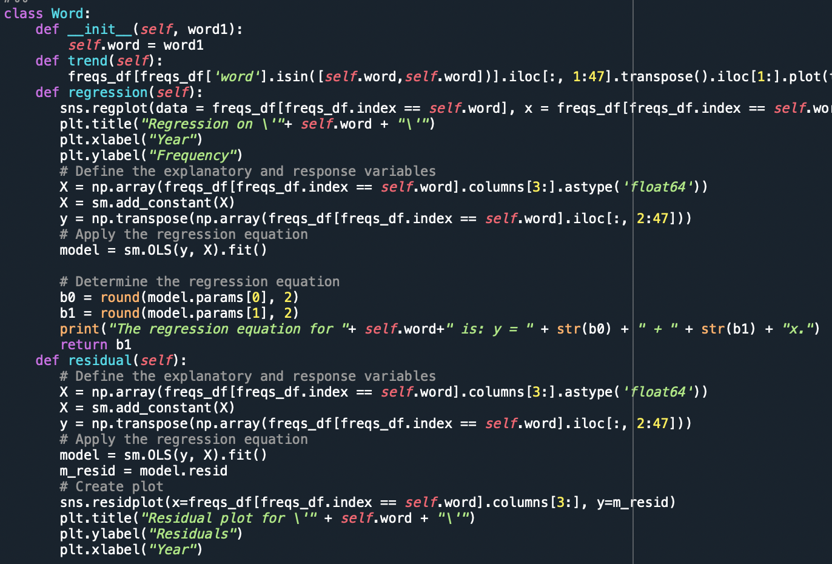
Word Class
class Word (self, word)
def trend(self):
Draws a line graph representing the frequency of the word over time
def regression(self):
Draws a regression for frequency over time, and prints the regression equation
def residual(self):
Creates the regression model and draws a residual plot for the word inputted
Research Question Data Summary Data Processing Visualizations Results Conclusions
Notes:
Tyler – in order to make our process more efficient, we created a class Word. It has three methods, trend, regression, and residual. It takes a word as an input and that draws and plots their respective graphs, with the exception of regression also printing the equation and returning the slope.

Slide 11
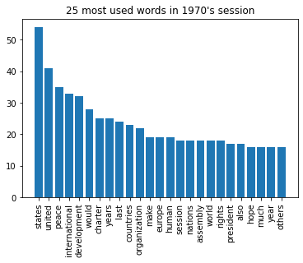
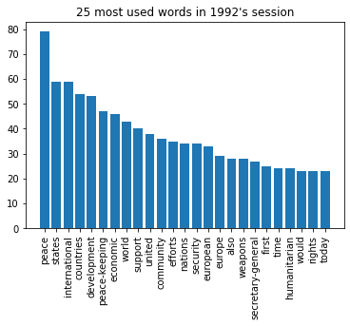
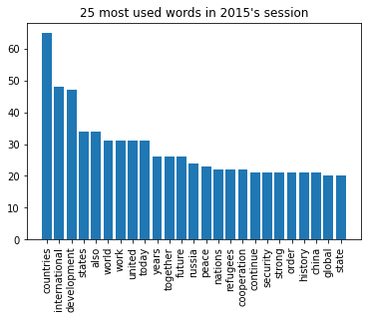
Data Exploration
Research Question Data Summary Data Processing Visualizations Results Conclusions
Notes:
Jordan

Slide 12
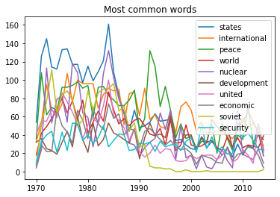
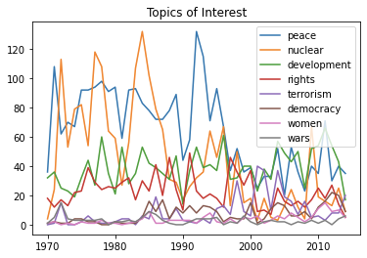
Defining Topics of Interest
Research Question Data Summary Data Processing Visualizations Results Conclusions
Notes:
Jordan

Slide 13
Results
Topics of Interest
Use of Regression Models and Equations
Observe changes in the focus of United Nation’s priorities
More Frequent Over Time
Less Frequent Over Time
Terrorism
Nuclear
Peace
Research Question Data Summary Data Processing Visualizations Results Conclusions
Notes:
Tyler- Using those words of interest, we can use the Word class to take a deeper look at the different topics and observe how the priorities of the UN has changed

Slide 14
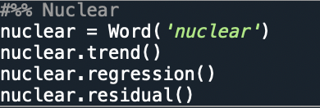


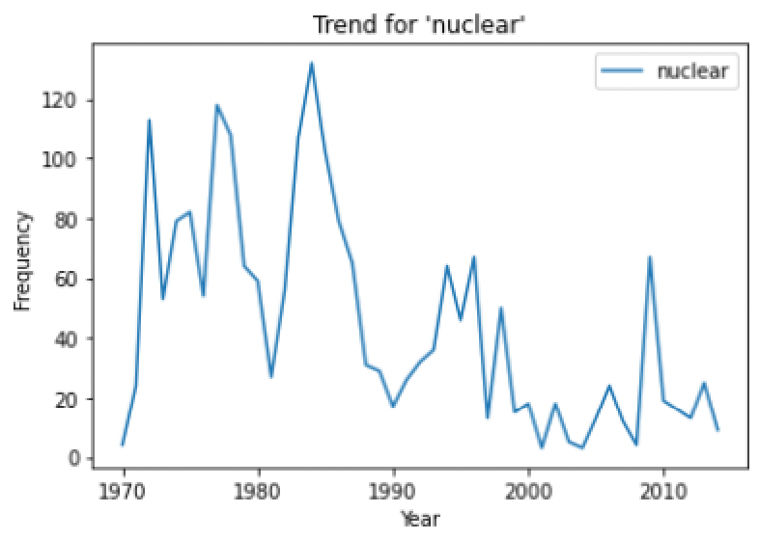
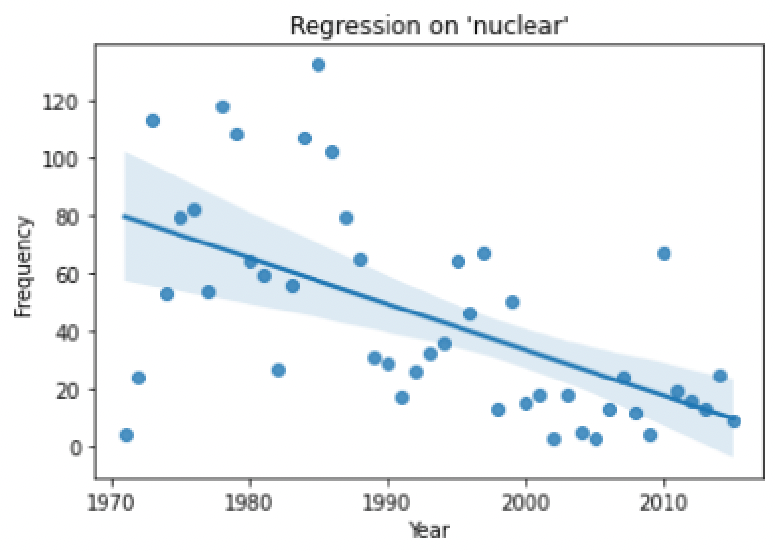
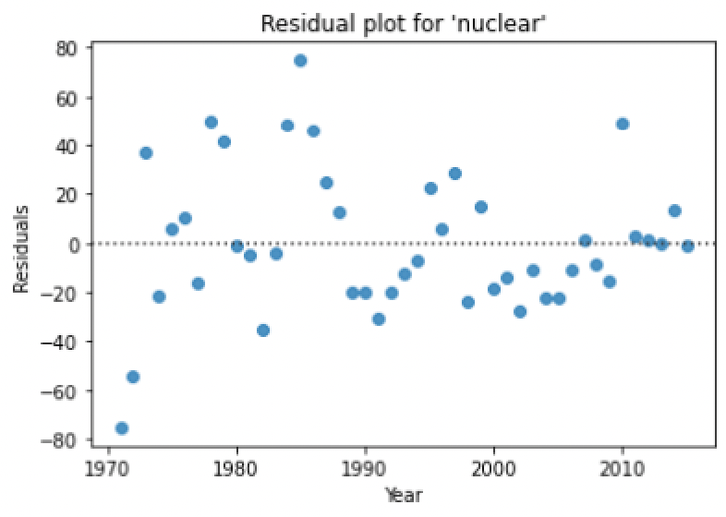
“Nuclear”
Nuclear: y = 3201.23 + -1.58x
Research Question Data Summary Data Processing Visualizations Results Conclusions
Notes:
Tyler- In order to plot graphs for the word nuclear, we create an object nuclear and call each of the methods on it. We can see how the frequency of this word has changed over time. Here, the line of best fit has a negative slope of 1.58.

Slide 15

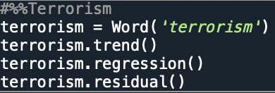
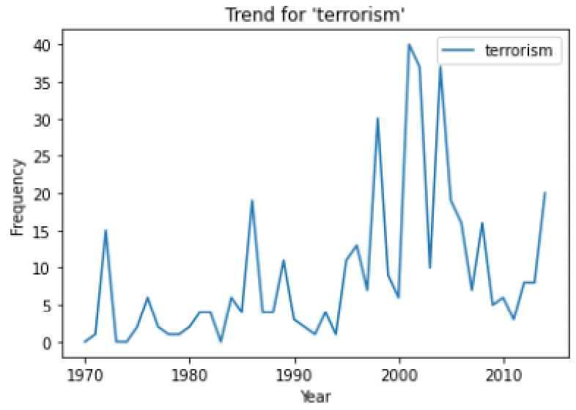
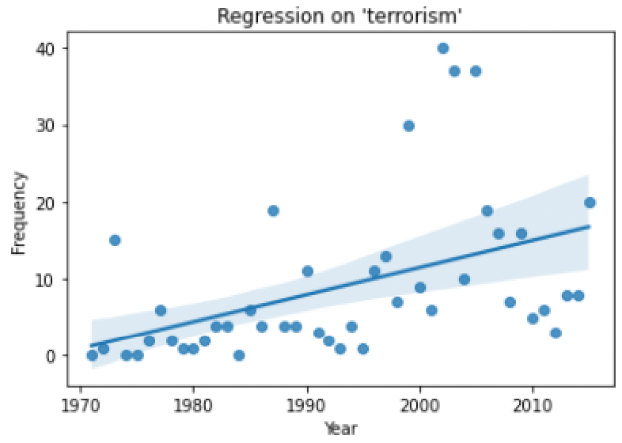
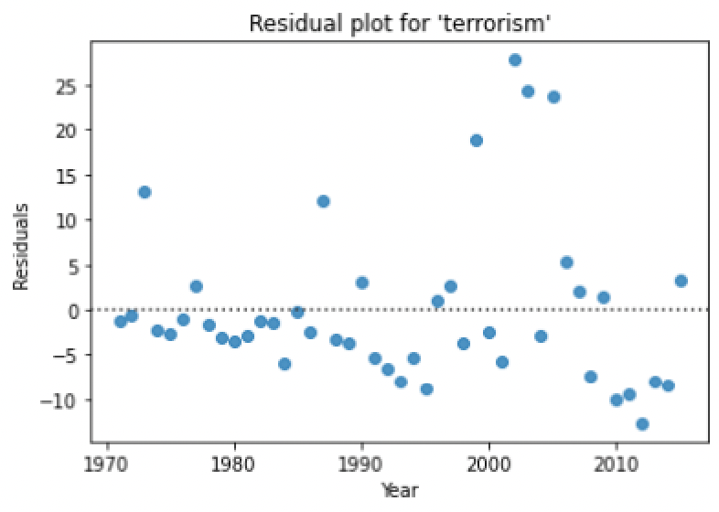
“Terrorism”
Terrorism: y = -691.57 + 0.35x
Research Question Data Summary Data Processing Visualizations Results Conclusions
Notes:
Tyler – The word terrorism on the other hand has a positive slope. Over the years, the word has been mentioned more and more. This data allows us to think about reasons for this increase, possibly due to 9/11 or conflict and instability in the middle east.

Slide 16
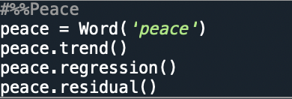

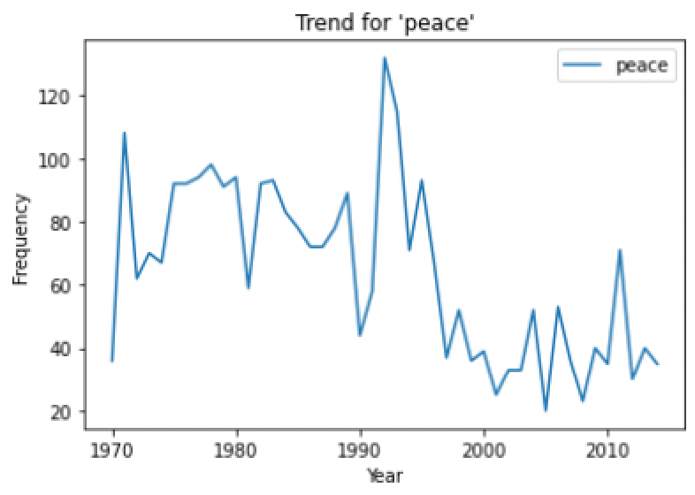
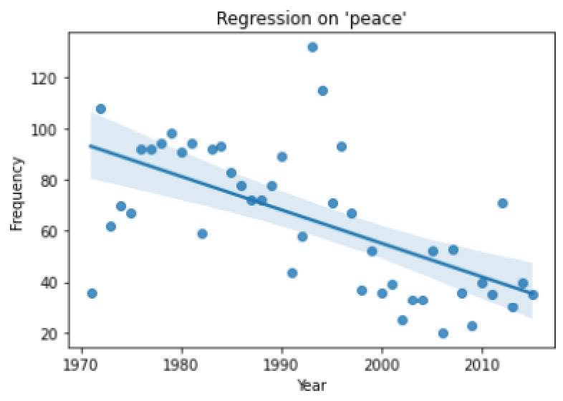
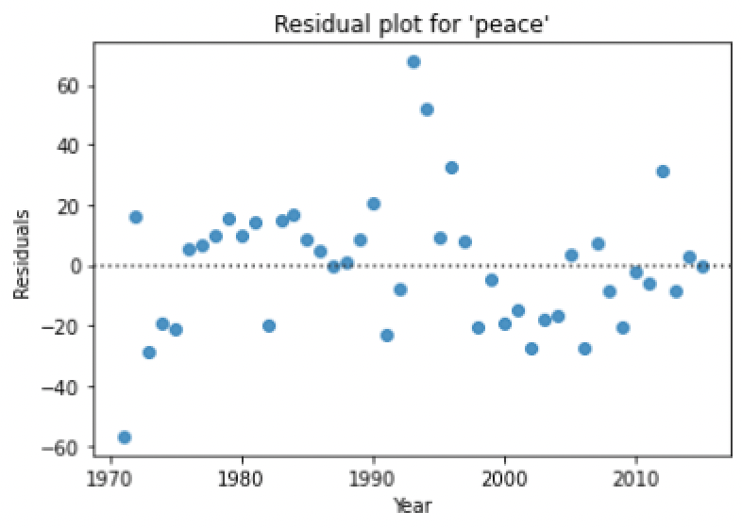
“Peace”
Peace: y = 2666.94 + -1.31x
Research Question Data Summary Data Processing Visualizations Results Conclusions
Notes:
Tyler- Last but not least, we have the word peace. As you can see, it’s usage is trending downward over time. Maybe this is due to the lack of major wars since the late 1900s.

Slide 17
Summary of Findings
Research Question
Regression Analysis
How have the focuses of the permanent members of the United Nations Security Council changed over time?
Change of Frequency
Significant Words
Increase
Democracy
Women
Terrorism
No Change
Development
Wars
Rights
Decrease
Nuclear
Peace
States
International
Peace
World
Nuclear
Development
United
Economic
Soviet
Security
Research Question Data Summary Data Processing Visualizations Results Conclusions
Notes:
Jordan

Slide 18
Applicability of Findings
1
Overview
Provides overview of significant topics and how they changed over time
2
Shows effect of major world wars and other events
Events
Shows effect of major world wars and other events
3
Discover
Leverages large data set to discover concise findings
Research Question Data Summary Data Processing Visualizations Results Conclusions
Provides overview of significant topics and how they changed over time
Shows effect of major world wars and other events
Leverages large data set to discover concise findings
Notes:
Jordan

Slide 19

Areas to Expand Functionality
Expand Analysis beyond UNSC
Analyze Correlations Between Different Words
Expand Into Other Topics and Words
Research Question Data Summary Data Processing Visualizations Results Conclusions
1. Expand analysis beyond the UNSC
- Look at different countries and regions
2. Analyze correlations between different words
3. Expand the topics to look at more than one word
-For example, it would be more informative for the topic of development to include other words grouped together such as aid, humanitarian, and development
Notes:
Tyler - Of course, our code and analysis isn’t perfect, and there is room for improvement. Given more time, we would look into expanding into other topics and words, for example, grouping the word aid and humanitarian to look at a topic of development. We could also analyze correlations between different words, and not just between one word over time. We also think expanding beyond the UNSC Permanent members is important, looking at different countries and regions.

Slide 20

Sources
UN General Debates Dataset:
https://www.kaggle.com/unitednations/un-general-debates?select=un-general-debates.csv
Research Question Data Summary Data Processing Visualizations Results Conclusions
Notes:
Tyler- Here is a link to our data set if you want to check it out.

